Slide 1
Operating Systems- II
Chapter 5 - Lecture 7
Dhanusha Somawardhana
BSc(Hons) it (SLIIT), MBA (UoW), Reading PhD (AeU)

Slide 2
Operating System Overview
Primarily a provider and manager of system resources like the processor, memory, I/O devices etc.
Provides features like user interface, data security etc.

Slide 3
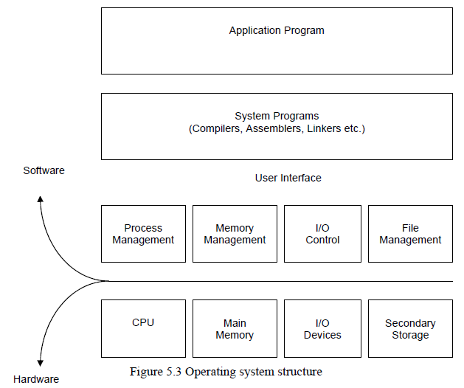
Operating System Structure

Slide 4
Processes
A process is that which is executed by the processor.
Process is an instance of a program in execution.
The smallest unit of work individually schedulable by the operating system.
Each multiprogramming operating system keeps a track of all the active processes and allocates system resources according to the priority.

Slide 5
Cont.
The operating system responds to commands by creating a process.
Leads to the creation and initialization of operating system data structures that are used for monitoring and controlling the progress of the related process.

Slide 6
Tasking
An Entire program is broken up into a number of processes that can be individually executed.
This breakup largely depends on the type operating system.
Implicit tasking - Operating system defining a process.
Explicit tasking - The programmer defining the process.
Explicit tasking is commonly used when high performance is required.

Slide 7

Process Relationships
Competition - A single system has limited resources. All the processes in the system compete with each other for the possession of these resources
Cooperation - cooperate with each other by sharing data and exchanging synchronization signals.

Slide 8

Cont.
Both competition and cooperation requires proper operating system support.
Competition - Requires careful allocation of resources.
Cooperation - Requires some mechanism, which will control the sharing of data and exchange of synchronization signals.
Cooperating systems typically share system resources and attributes.
Grouped processes is called as family of processes
Parent – child Processes

Slide 9
Interrupt System
Through the interrupt system, a process can inform the operating system about the occurrence of certain event.
Can be used to simultaneously execute a number of programs by the processor.
The overall control is retained by the operating system.

Slide 10
Types of interrupts
I/O interrupts - Signal the completion of an I/O activity, the occurrence of an error or failure condition. Generated by an I/O device controller.
Timer interrupts - Generated by the internal clock of the processor. Signals the operating system at pre-defined intervals to attend some crucial job.
Hardware Error interrupts - Generated by the operating system signifying hardware faults.
Program interrupts - Generated by error conditions arising from user programs.

Slide 11
DMA –Direct memory access
Technique used for data transfer between the memory and I/O devices.
Reduces the load on the processor.
Has access to the data bus.
Transfer data in and out of the memory.
Suspends the CPU and uses the clock cycles to transfer a block of data from the memory to a peripheral device. (cycle stealing)

Slide 12
Memory Addressability
Each memory Location has an address.
Each address has a unique identifier.
The way in which computer identifies memory location is called addressability.

Slide 13
File management
‘Files’ means the data that is held in the secondary storage.
OS support different file types.
Example : Fedora File Types
Regular | Regular simple files such as programs, text etc.
Directory | Files that contains reference to other files
Char / block special | These are files that refer to hardware devices
Pipe | Basically a queuing buffer that holds the standard output of one process and sends it to another process

Slide 14
File system services
On-line facilities - Provides various interactive facilities to work with files, built-in and provided by separate utility programs.
Ex: Del , Rename
Programming Services – Services that provided to the programmer to allow him to use files from within applications.
Ex: Open, Close

Slide 15
Disk Space Management
Management of blocks is similar in concept with the management of memory blocks described in memory management.
Contiguous allocation –
Keep a track of the contiguous free areas in the disk and allocate them to files as and when required.
Blocks are allocated or de-allocated their corresponding entries in the list is modified.
The disadvantage of contiguous allocation is that it is often difficult to find free space for a new file

Slide 16
Cont.
Noncontiguous Allocation –
Chaining
Indexing
Chaining - Each block contains a pointer to the next block in sequence.
Indexing - Contains the address of an index block.

Slide 17
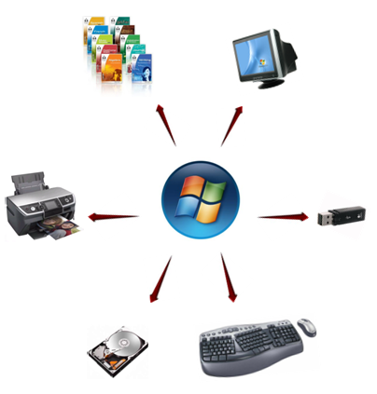
Peripheral Management
An important role of the operating system is as the manager of peripherals.

Slide 18
Operating System Design Issues
Design Objectives
Efficiency
Generality
Logical Structure of the I/O Functions
Ex: Device I/O, File System

Slide 19
I/O Buffering
Mechanism that improves the amount of input and output operations.
The block-oriented devices store information in the form of blocks.
Stream-oriented devices transfer data as streams of bytes.
Buffering three kinds:
1. Single buffer
2. Double buffer
3. Circular buffer

Slide 20

Single buffer
The operating system maintains a single buffer in the system area of the main memory.
Input transfer is first made onto the buffer.
Once the transfer is complete, the process moves the contents of the buffer to the user space and requests the next block.

Slide 21
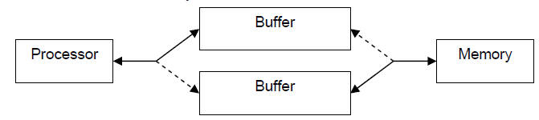
Double buffer
The operating system maintains two buffers in the system area of the main memory.
Transfer is carried out in similar fashion as that in single buffer system.

Slide 22
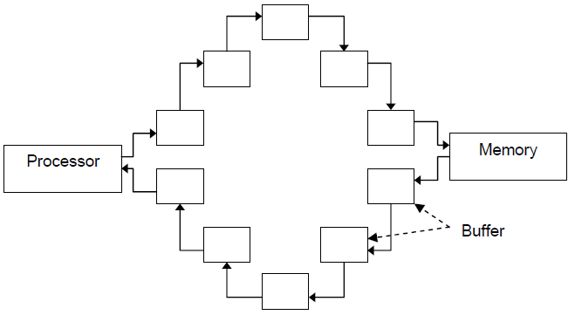
Circular Buffer
Single buffer and double buffer can be effectively used if the transfers are relatively infrequent.
To avoid slow data transfer, a collection of buffer termed as circular buffer is used.

Slide 23
Thank you…!!!

